Slide 1

[AIS]AWS Estimated cost & Assumed TPS

Slide 2

TPS & Iops
ㅇExpected PEAK TPS(Example REC)
Cpu Core * qty *200
REC as an example
- Expected Peak TPS of 6,200TPS at 3.1m
- Expected Peak TPS 11,400TPS at 5.8m
The IOPS throughput of REC DB is as follows. db.r6i.2xlarge: 12,000 * 2.5 = 30,000 iops (refer to page 2)
3.1M * 0.1(Cuncurrency User) *0.1(Interval) *0.2(Rate)
***Summary
IOPS and TPS are not the same concept.
However, when looking at the hit rate (iops) of the service server-DB-Storage for processing transactions,
it was judged to be Iops that accommodate the expected traffic.
ㅇREC Server – DB Structure
r6i.4xlarge
Auto Scaling group
REC
POD
REC
POD
REC
POD
REC
POD
ㅇ TPS 12,800 -> Peak traffic 6200TPS
ㅇ Write IOPS 20% of total traffic, 2.5 IOPS of 1TPS
: 1240TPS * 2.5 IOPS = 3,100 IOPS
ㅇ Read IOPS 80% of total traffic, 1.5 IOPS of 1TPS
: 4960TPS * 1.5 IOPS = 7,440 IOPS
ㅇTotal IOPS is 10,540 IOPS
ㅇWhen looking at simple numbers, it comes in the 12,000 IOPS range.
EKS Node Group
REC RDS
db.r6i2xlarge

Slide 3
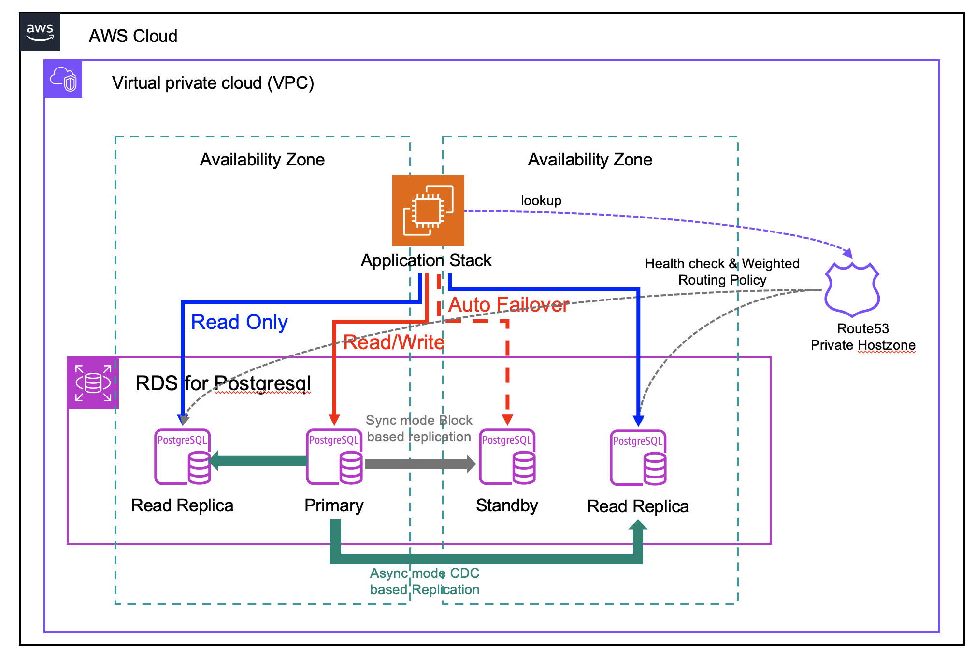
AWS RDS Architecture
ㅇAWS RDS Architecture we've plan to provisioned PostgreSQL database as AWS RDS with Multi-AZ feature.
ㅇAWS RDS service serve a feature for HA and redundancy by Multi-AS and Read Replicas.
ㅇWill be going to provisioned to begin with RDS Primary and Standby instance. And then for those are purpose to leverage only to CUD transaction, need to provisioned read replicates.
ㅇIn case of Primary instance some reason to failure or maintenance such of reboot, can be switch Standby instance promote to primary. But beside this situation standby instance can't leverage as service transaction.

Slide 4
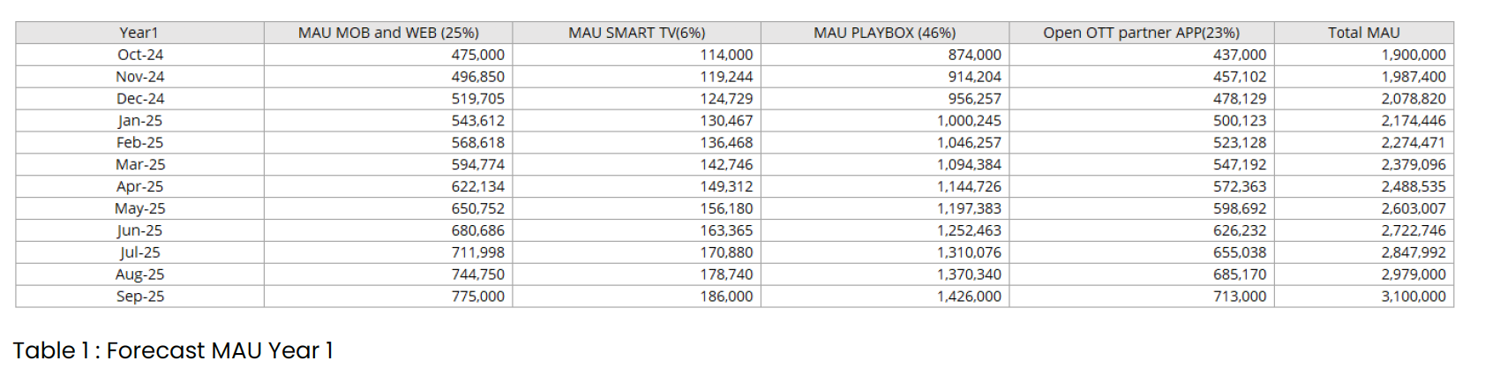
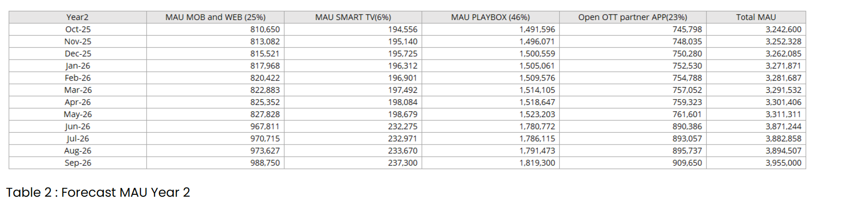
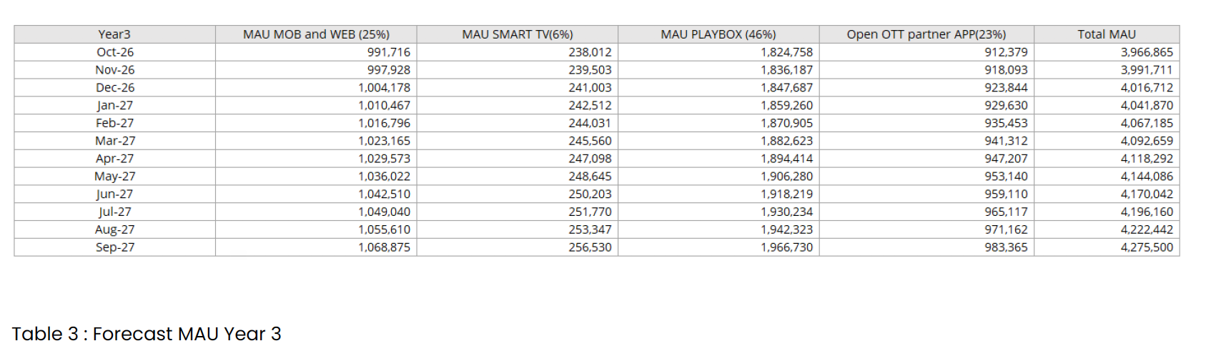
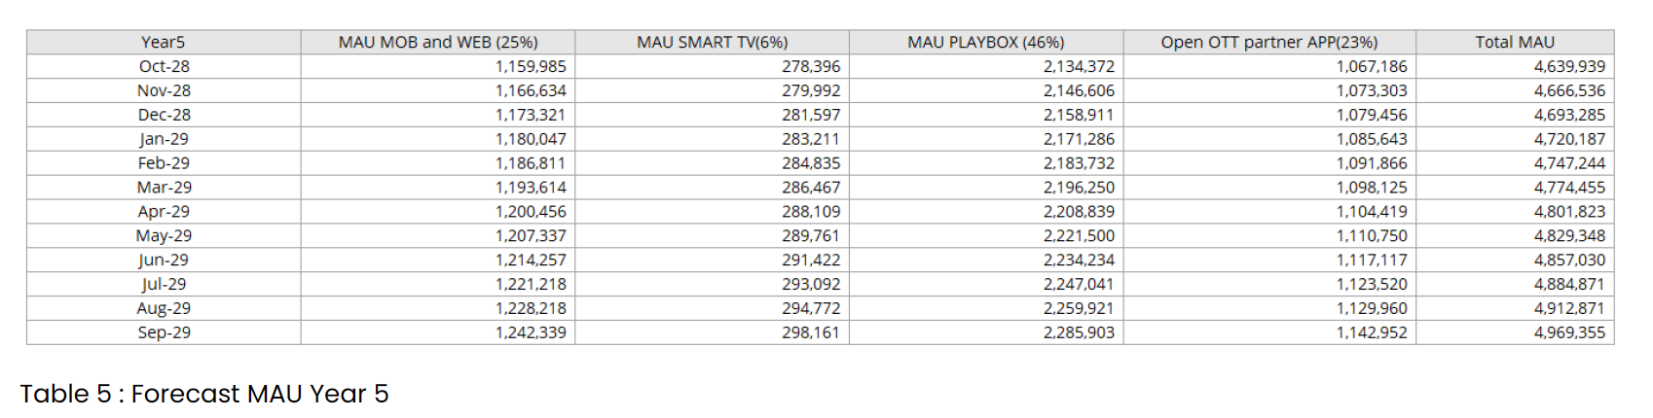
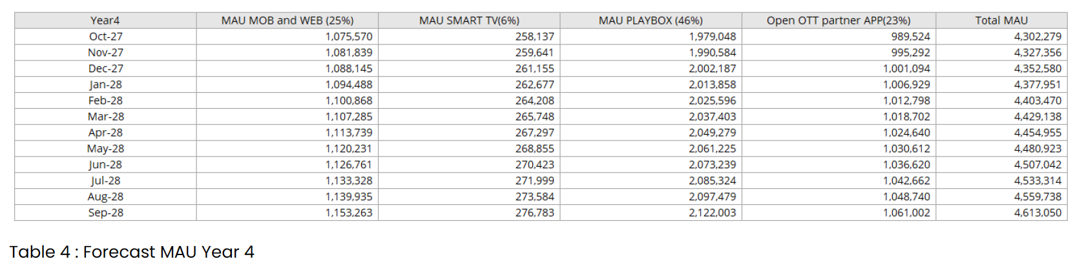
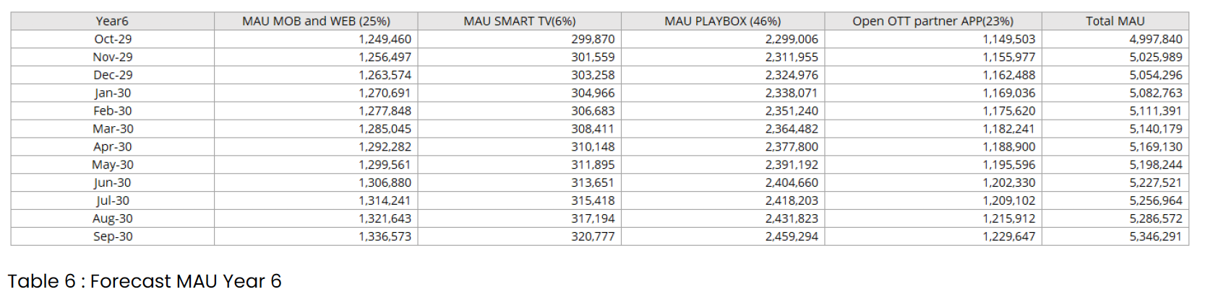
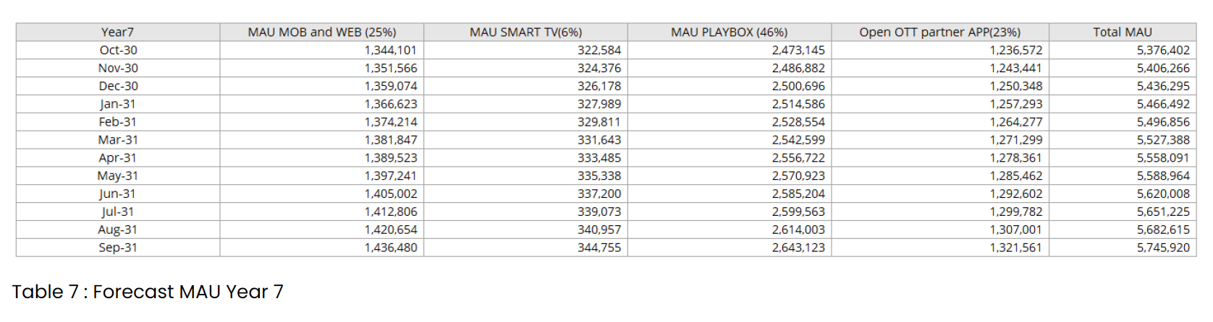
Appendix. Calculation of standard capacity for this project
ㅇ 3BB standard capacity
Assuming that 200 tps per core can be processed, in case of 5 million, concurrent tps is calculated and reversed
Case1) 3BB
30,000 concurrency based on 300,000.
Interval 10 seconds = 3000 TPS -> 1700 TPS
Case2) 3BB
70,000 concurrency based on 700,000.
Interval 10 seconds = 7000 TPS -> 4000TPS(About interval 17sec)
*** Actual 3BB PROD environment traffic 4000TPS
Case 3) AIS
500,000 concurrency based on 5 million,
Interval 10 seconds = 50,000 TPS -> 30,000TPS(When forecasted based on 3bb, 30,000 TPS)
500,000 / 10sec = 50,000 tps
Case 4) AIS
300,100 concurrency based on 3.1 million,
Interval 10 seconds = 30,010 TPS
Case5) Application
Qty * CPU Core * 200TPS/perCore (up to 250 TPS )
- Baseline I/O Operations/second (IOPS)
db.r6i.xlarge: 6,000 *2.5
db.r6i.2xlarge: 12,000 * 2.5
db.r6i.4xlarge: 20,000 *2.5
IOPS is given depending on the DB type.

Slide 5
Appendix. 3BB case-based formula comparison
We will explain TPS calculations based on AIS subscriber forecasts.
3BB IPTV’s maximum traffic analysis results,
Compared to the TPS calculation formula applied to the AIS AWS infrastructure, it was found to have an error range of approximately 40%.
TPS calculations are fundamental to infrastructure design. Since we had to assume the worst case, the calculation was based on approximately 40% or more of the actual traffic that would occur. Of course, the actual traffic generated may have a margin of error depending on the subscriber situation and service characteristics.
[AIS calculated TPS]
Subscriber/concurrent 10%/10sec interval = TPS
[3BB Prod-Environmental TPS]
700,000/concurrent10%/10sec = 7000TPS
700,000/concurrent10%/10sec*((100-43)/100) = 4000TPS
[Formula based on 3BB actual case analysis]
500,000 concurrency based on 5 million,
-> Interval 10 seconds = 50,000 TPS (500,000 / 10) → AWS resource calculation basis TPS
-> 50,000 TPS *((100-43)/100) = 28,500 TPS. -> Actual traffic forecast based on 3BB reference

Slide 6
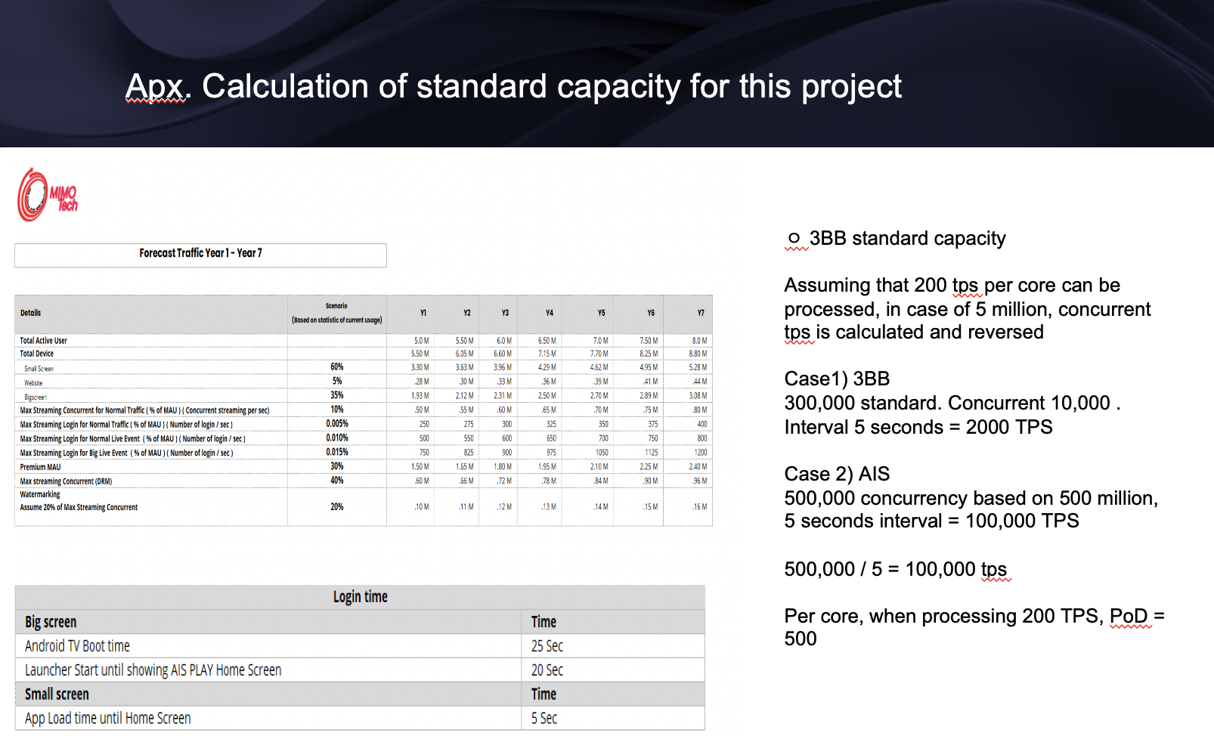
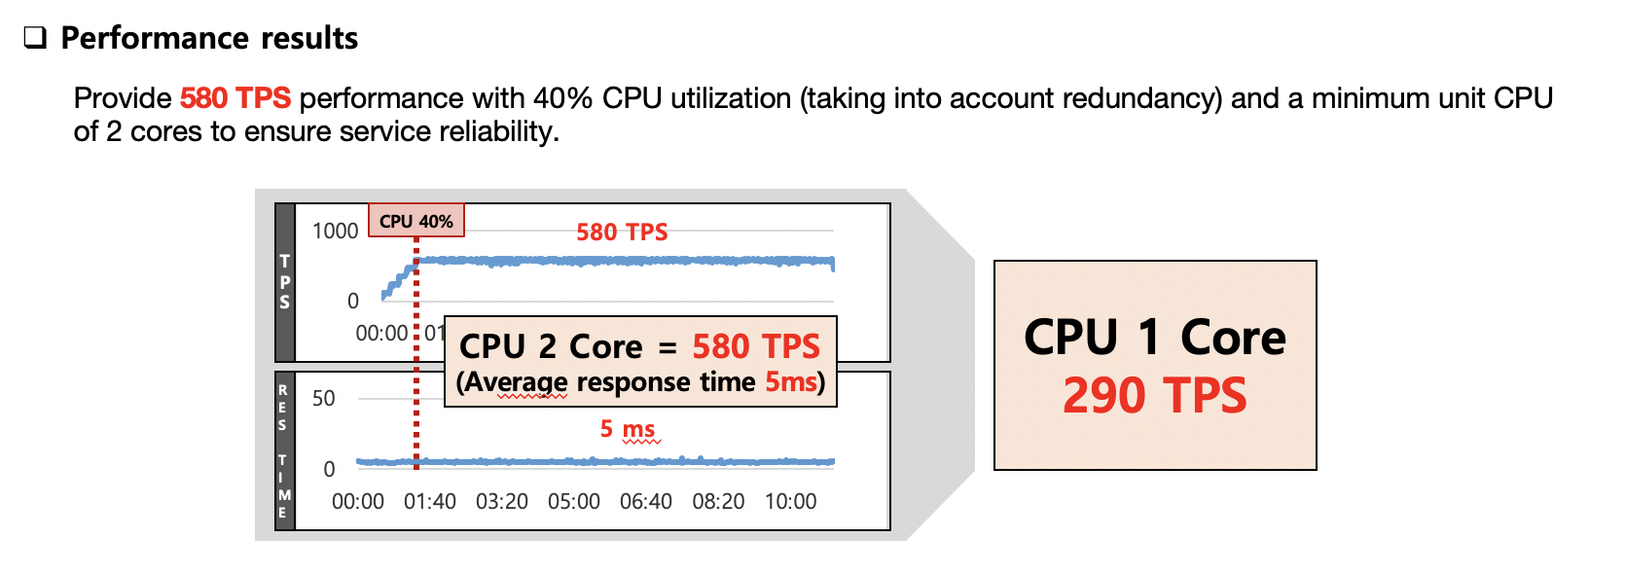
Appendix. Performance forecast history
Initial forecast version for 2023
ㅇ Calculation formula
- Concurrent users: 10% of subscribers
- Interval time change history
1. Reasons for 5 second intervals (2023)
. 3BB Interval value used when measuring IPTV performance.
2. Reason for change to 10 second interval (2024)
. 3BB When comparing actual traffic, 1.5 to 2 times TPS error range occurs
. Calculated by changing the Interval from 5 seconds to 10 seconds to optimize AWS resources (Refer to page 2)
3. Reason for change from 200 TPS to 250 TPS per CORE
- For AWS optimization, 250TPS processing capacity was calculated through APIGW's performance test. Refer to the table below.
MBS APIGW Peformance
ㅇ API GW performance
- APIGW's performance can handle 290 TPS per core based on 40% CPU.
- The standard value used when calculating AWS resources is 250 TPS. This is a conservative figure and has a buffer of approximately 20%.
- Core's standard value is a conservative estimate of resources, measuring approximately 20% buffer + 40% CPU of maximum processing capacity.

Slide 7

Hybrid Architecture plan.
Plan-1(Hybrid Archi.)
Plan-2(On-premise Archi.)
AWS
Hybrid 3BB infra
AWS
On-Premise
c
c
Small Screen(OTT)
RedHat
OpenShift
Big screen(STB,Web)
Small Screen(OTT)
Big screen(STB,Web)
AWS
EKS
DVP
POD
DVP
POD1
DVP
POD2
AWS
EKS
DVP
POD
DVP
POD1
DVP
POD2
On-
premise
DVP
POD
DVP
POD
DVP
POD #N
DVP
APP1
DVP
APP2
DVP
APP#N
EC2
EC2
EC2
EC2
EC2
EC2
EC2
Bare
metal
Bare
metal
Bare
metal
EC2
EC2
Bare
metal
Bare
metal
Bare
metal
EC2
EC2
EC2
…
…
Virtual Machine
Virtual Machine
Advantages: Can configure the same app configuration as Cloud
Advantages of app configuration and deployment management
Cons: Adds Openshift deployment and management costs
There is a need to prepare a management plan for Openshift
[Note]
ㅇ Commercial license fees are incurred in addition to separate construction costs.
ㅇ OpenShift 1 core $1200, 3552 Core required for 2.32m(MAU)
-> About $4.3 million
ㅇ OpenStack is required for VM, and due to the cost of approximately 5 million won per node, it is necessary to build on a bare metal basis.
Advantages: Easy to build with simple infrastructure structure
Openshift no additional cost.
Cons: Difficult to set up infrastructure for adding or expanding services
[note]
Only system migration costs are incurred.
- No licensing fees related to virtualization or containers.

Slide 8
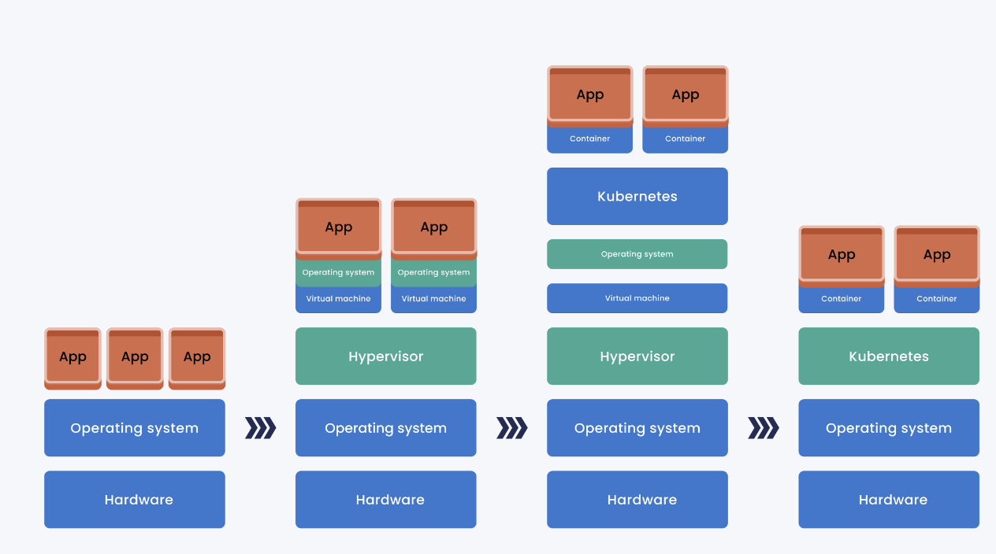
Bare metal & Containerization
OpenShift
OpenShift
OpenStack
Bare Metal
(3BB IPTV)
virtualization
Virtualization & Containerization
(AIS DVP based VM)
Containerization based Bare metal

Slide 9

Hybrid Archi.
AWS
On-Premise
c
c
Small Screen(OTT)
Big screen(STB,Web)
EKS
DVP
system1
DVP
system2
DVP
System #n
K8s
DVP
system1
DVP
system2
DVP
System #n
RDS
DB
1.In the AIS IPTV hybrid environment (Big/Small screen), the most important part is data synchronization
2. There are many ways to solve this, such as CDC and DMS, but synchronization with concurrency actually causes many problems.
3. We propose the following for a fundamental solution to the above problem.

Slide 10
Hybrid plan-1
AWS
AWS
On-Premise
c
c
c
Small Screen(OTT)
Small Screen(OTT)
Big screen(STB,Web)
EKS
DVP
system1
DVP
system2
DVP
System #n
EKS
DVP
system1
DVP
system2
DVP
System #n
K8s
DVP
system1
DVP
system2
DVP
System #n
RDS
RDS
DB
Data migration
1. Data standard information management in the DPV system involves on-premise DB management.
2. Used in conjunction with DBCP in a SmallScreen environment.
AWS
On-Premise
c
c
Small Screen(OTT)
Big screen(STB,Web)
EKS
DVP
system1
DVP
system2
DVP
System #n
K8s
DVP
system1
DVP
system2
DVP
System #n
RDS
DB

Slide 11
Hybrid plan-2
AWS
AWS
On-Premise
c
c
c
Small Screen(OTT)
Small Screen(OTT)
K8s
Big screen(STB,Web)
EKS
DVP
system1
DVP
system2
DVP
System #n
EKS
DVP
system1
DVP
system2
DVP
System #n
DVP
system1
DVP
system2
DVP
System #n
RDS
M
S
S
RDS
DB
M
S
S
S
S
1.Data standard information management in the DPV system involves on-premise DB management.
2. Used as RDS + On-Premise Master-slave-slave-slave-slave structure in SmallScreen environment.
AWS
On-Premise
c
c
Small Screen(OTT)
K8s/
OKD
Big screen(STB,Web)
EKS
DVP
system1
DVP
system2
DVP
System #n
DVP
system1
DVP
system2
DVP
System #n
RDS
M
S
S
DB
S
S

Slide 12





Thank you
Copyright 2022 © MEGAZONECLOUD CORP. ALL RIGHT RESERVED.

